Slide 1
Useful Diagrams
Sample Transfer & Handling System
Joseph Bowkett
MSR-SRL-STS In-Contact Manipulation

Slide 2
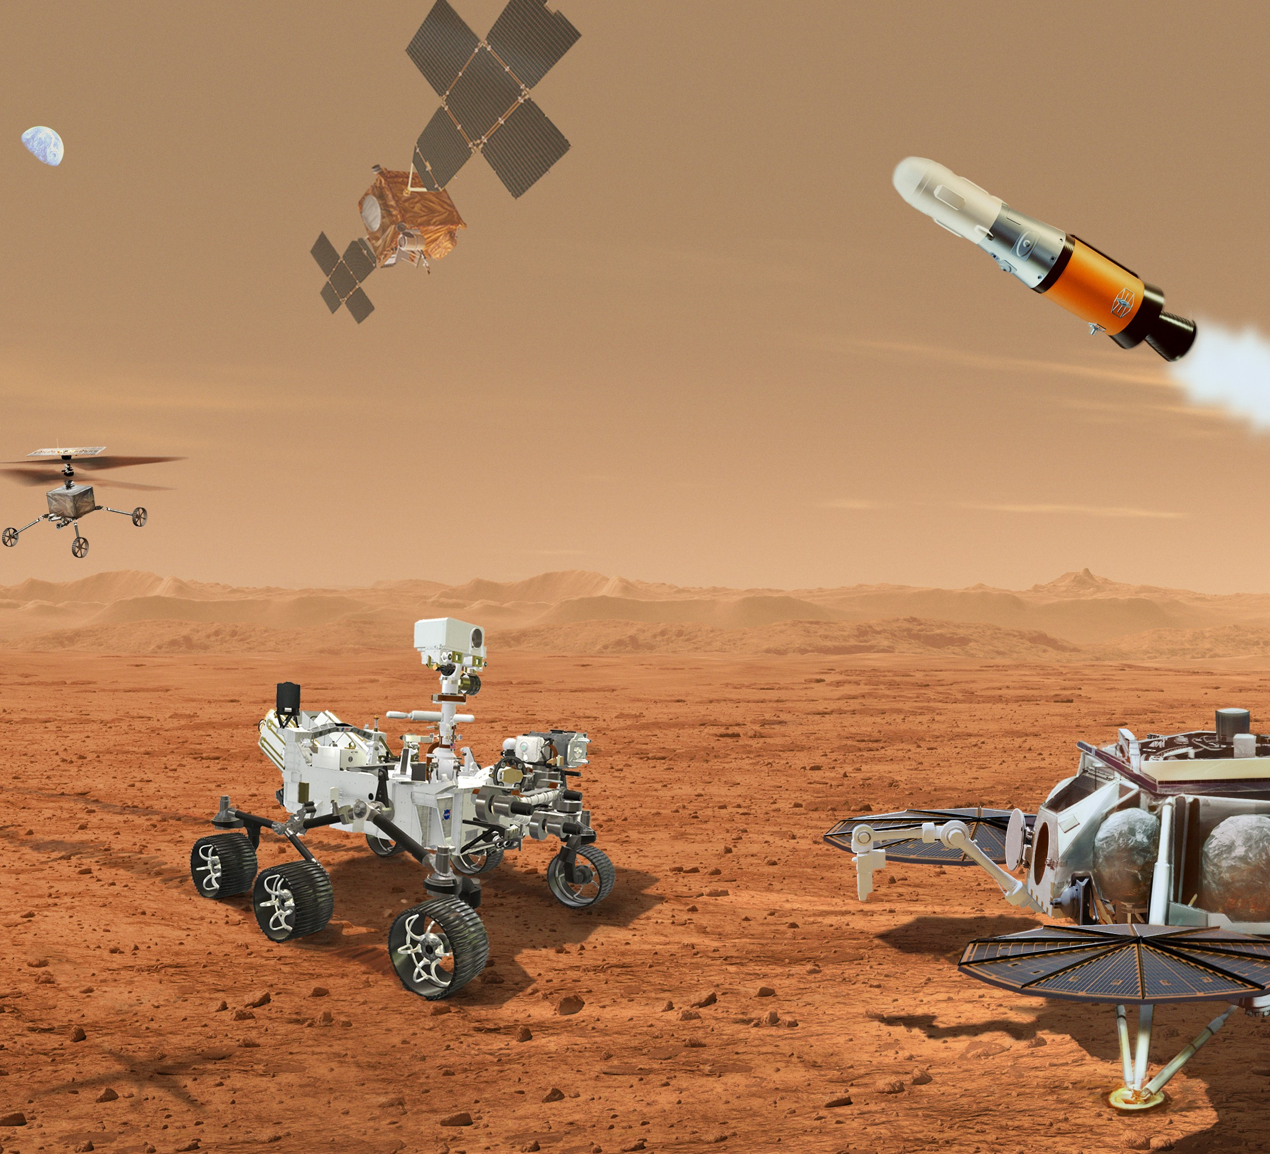

Slide 3

















Pure Force Regulation
Pure Position Trajectory
Mixed Position & Force
Mixed Position & Compliance
Tool Tip Frame
$$x$$
$$F_{x}$$
$$V_{x}$$
$$F_{x}$$
$$C_{x}$$
Tool Tip
$$z$$
$$F_{z}$$
$$V_{z}$$
$$V_{z}$$
$$V_{z}$$
$$y$$
$$F_{y}$$
$$V_{y}$$
$$F_{y}$$
$$C_{y}$$
$F$ = force
$V$ = velocity

Slide 4


















Subfunctions Summary
The tasks these capabilities/tools need to enable
The “functions” and “subfunctions” that In-Contact Manipulation (ICM) needs to perform can be broken down into:
Pure Force Regulation
Pure Position Trajectory
Mixed Position & Force
Mixed Position & Compliance
Tool Tip Frame
$$x$$
$$F_{x}$$
$$V_{x}$$
$$F_{x}$$
$$C_{x}$$
Tool Tip
$$z$$
$$F_{z}$$
$$V_{z}$$
$$V_{z}$$
$$V_{z}$$
$$y$$
$$F_{y}$$
$$V_{y}$$
$$F_{y}$$
$$C_{y}$$
$F$ = force
$V$ = velocity
$C$ = compliance
How we describe control for a given capability/behavior +Z is taken as the axial direction for cylindrical tools
Static preloading against a station
E.g. during STS OS lid closure
or M2020 ARM_PRELOAD
Only consideration of force/torque is in checking of fault limits
E.g. moving in free space
Motion in one axis, while regulating or nulling forces in others
E.g. RGA extraction from M2020 or OS
Motion in one axis, while “actively complying” in others to accommodate misalignment
E.g. RGA insertion to OS sleeve

Slide 5
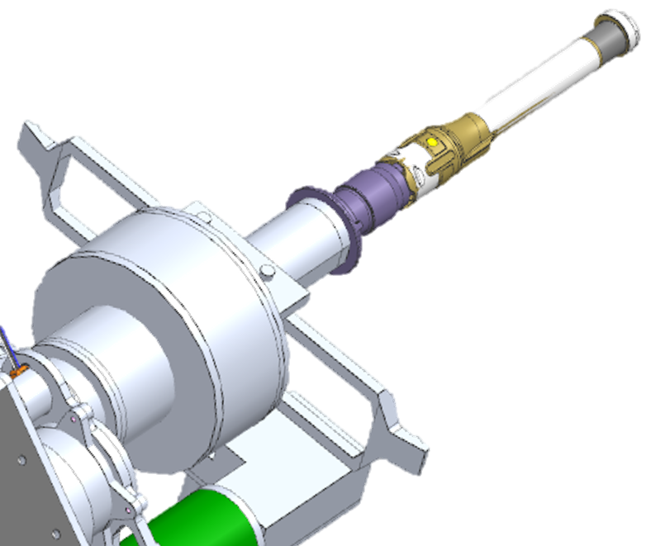
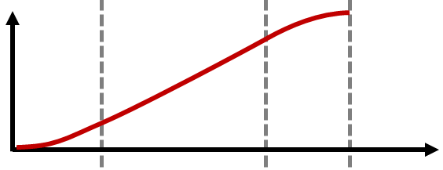






Baseline trajectory
TAKEAWAY: How the first two pieces operate
Baseline Goal Pose
Baseline
Trajectory
Baseline Goal Pose
y
Baseline
Trajectory
Initial
Pose
$$x_{0}(t)$$
Initial Pose
y
z
x
x
z
$$d(t)$$
$$d_{goal}$$
$$d(t)$$
$$v_{max}$$
Time
Nominal Trajectory Progress
Time
$$a_{max}$$
Notes:
Point out that the dashpot is necessary to make the system stable
Call out how dependent

Slide 6









Baseline trajectory slowdown
TAKEAWAY: How the first two pieces operate
Baseline Goal Pose
Baseline Goal Pose
Baseline Trajectory
Baseline Trajectory
$$F_{z}$$
$$x_{0}(t)$$
$$F_{z}$$
$$x_{0}(t)$$
Initial
Pose
Initial
Pose
y
y
$$s_{slow}(F_{z})$$
x
$$s_{slow}(F_{z})$$
x
z
z
$$s(t)$$
$$s(t)$$
$$F_{z}= d_{traj}{\dot{s}}_{slow}$$
$$F_{z}= d_{traj}{\dot{s}}_{slow}$$
Notes:
Point out that the dashpot is necessary to make the system stable
Call out how dependent

Slide 8





SRL-STS Active Compliance Formulation
$$p_{δ}=position control delta$$
Insertion axis
Peg
Chamfered hole
$$C_{active}$$
CC
$$C_{mech}$$
$$C_{net}=C_{active}+C_{mech}∈ℝ_{+}^{6×6}$$

Slide 9








$$x(t)$$
$$x(t)$$
Nominal Goal Pose
$$k$$
$$k$$
$$F(t)$$
$$F(t)$$
$$d$$
$$x_{0}(t)$$
$$d$$
$$x_{0}(t)$$
Initial Pose
Spring-Dashpot dynamics:
Spring-Dashpot dynamics:
$$F= d\dot{x}+k(x−x_{0})$$
$$F= d\dot{x}+k(x−x_{0})$$

Slide 10







$$x(t)$$
$$x(t)$$
Nominal Goal Pose
$$k$$
$$k$$
$$m$$
$$m$$
$$F(t)$$
$$F(t)$$
$$d$$
$$x_{0}(t)$$
$$d$$
$$x_{0}(t)$$
Initial Pose
Spring-Dashpot-Mass dynamics:
Spring-Dashpot-Mass dynamics:
$$F=m\ddot{x}+d\dot{x}+k(x−x_{0})$$
$$F=m\ddot{x}+d\dot{x}+k(x−x_{0})$$

Slide 11
$$x(t)$$
Baseline Goal Pose
$$k$$
$$m$$
$$F(t)$$
$$d$$
$$x_{0}(t)$$
Initial Pose
Mass-Spring-Damper dynamics:
$$F=m\ddot{x}+d\dot{x}+k(x−x_{0})$$

Slide 12



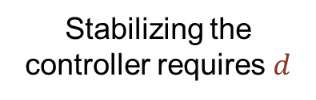


Active Compliance: Trajectory & Control
Stabilizing the controller requires $d$
TAKEAWAY: How the first two pieces operate
$k$ emulates an RCCM
$$x(t)$$
$$k$$
Nominal
Trajectory
Nominal Goal Pose
$$F(t)$$
Initial
Pose
$$x_{0}(t)$$
$$d$$
$$x_{0}(t)$$
y
x
z
$$d(t)$$
Spring-Dashpot dynamics:
$$d(t)$$
$$F= d\dot{x}+k(x−x_{0})$$
Time
Until we make contact, the nominal trajectory behaves much like a heritage “Cartesian” tool frame motion controller with a trapezoidal profile
Once we experience a force, the virtual nominal trajectory marches forward while the commanded position deflects like an RCCM
Notes:
Point out that the dashpot is necessary to make the system stable
Call out how dependent

Slide 13
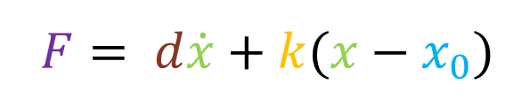
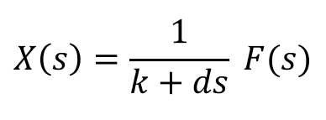
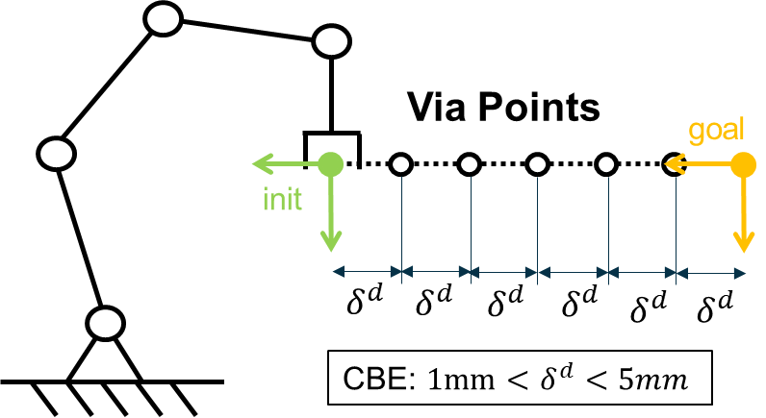
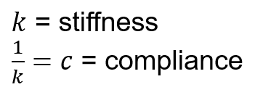
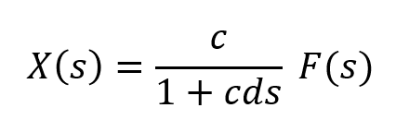

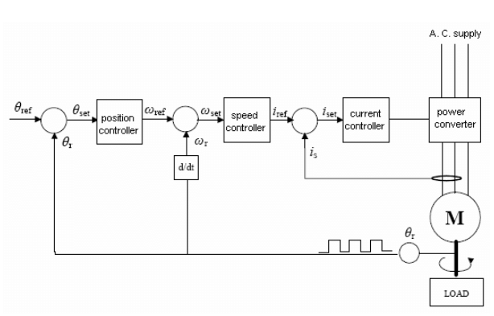
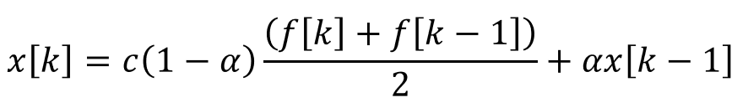
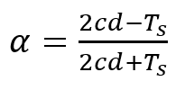

Active Compliance: Discretization & Kinematics
TAKEAWAY: How the second two pieces operate
Jacobian “via” at each point limits kinematics impacts
(a low pass filter of DC gain $c$)
Bilinear/Tustin discretization:
Individual joint control is supplied by the SCU
AC Difference equation:
where
dictates damping
“Cascaded” joint controller heavily influences force control stability
Discretization of the continuous control law follows standard Bilinear discretization and essentially produces a low pass filter
Jacobians are pre-computed onboard before motion start, we are highly dependent on the performance of the SCU
Notes:
Should focus more on SCU joint control performance on the right,
Turn this box towards SCU dependence

Slide 14
Compensation vs Augmentation

Slide 15
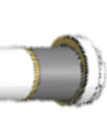






Force Regulation Control Diagrams
$$F_{x}$$
$$F_{x}$$
$$F_{z}$$
$$V_{z}$$
$$F_{y}$$
$$F_{y}$$
Pure Force
Axial Velocity Lateral Force

Slide 16




Force Regulation : Trajectory & Control
TAKEAWAY: How the first two pieces operate
Nominal Goal Pose
Nominal
Trajectory
Nominal Goal Pose
$$x_{0}(t)$$
Initial
Pose
$$x_{0}(t)$$
y
Initial Pose
$$F_{desired}(t)$$
x
z
$$d(t)$$
$$F_{sense}(t)$$
Closed loop force controller:
$$d(t)$$
Time
$$F_{desired}−F_{sense}=F_{error}$$
Until we make contact, the nominal trajectory behaves much like a heritage “Cartesian” tool frame motion controller with a trapezoidal profile
Once we experience a force, the virtual nominal trajectory marches forward while the commanded position deflects like an RCCM
Notes:
Point out that the dashpot is necessary to make the system stable
Call out how dependent

Slide 17








Force Regulation
Baseline Goal Pose
$$x_{0}(t)$$
$$x_{0}(t)$$
Initial Pose
$$F_{desired}$$
$$F_{desired}$$
$$F_{sense}(t)$$
$$F_{sense}(t)$$
Closed loop force controller:
Closed loop force controller:
$$F_{error}=F_{desired}−F_{sense}$$
$$F_{error}=F_{desired}−F_{sense}$$

Slide 18
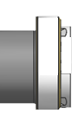
Chamfer Find
1. Axial Move to Contact
3. Lateral Move to Center
2. Lateral Move to Contact x2

Slide 19


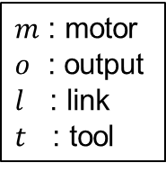





































Control Diagrams
$$J_{r}$$
$$D_{m}$$
$$ratio:n$$
$$D_{o}$$
$m$ : motor
$o$ : output
$l$ : link
$t$ : tool
$${ J}_{m}$$
$${ J}_{o}$$
Actuator without link
$$τ_{o}$$
$$τ_{m}$$
$$K_{o}$$
$$q_{m}$$
$$q_{o}$$
$$D_{m}$$
$$ratio:n$$
$$D_{o}$$
$$D_{l}$$
$${ J}_{m}$$
$${ J}_{o}$$
$${ J}_{l}$$
Actuator with link in free space
$$τ_{m}$$
$$τ_{l}$$
$$K_{o}$$
$$K_{l}$$
$$q_{m}$$
$$q_{o}$$
$$q_{l}$$
$$D_{m}$$
$$ratio:n$$
$$D_{o}$$
$$D_{l}$$
$$D_{t}$$
$${ J}_{m}$$
$${ J}_{o}$$
$${ J}_{l}$$
Actuator with link in against station
$$τ_{m}$$
$$K_{o}$$
$$K_{l}$$
$$K_{t}$$
$$q_{m}$$
$$q_{o}$$
$$q_{l}$$

Slide 20
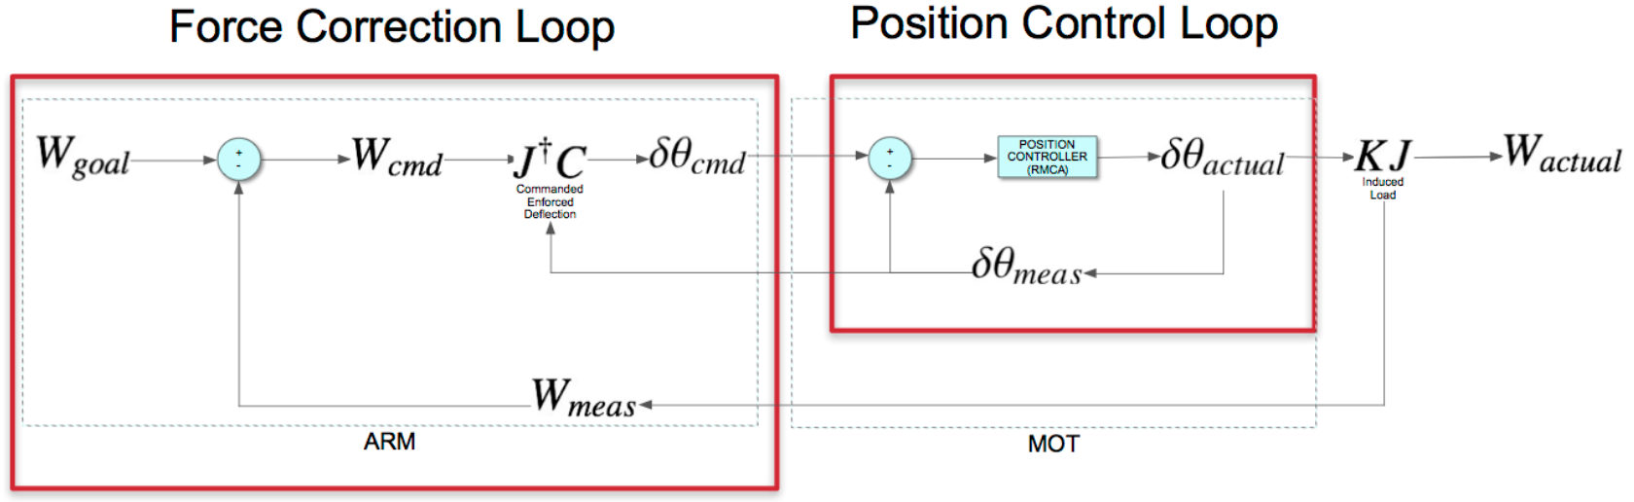
M2020 FDD diagram for ARM_PRELOAD

Slide 21





Enforced Deflection Diagram
$$F_{desired}$$
$$F=kx$$
$$k_{mech}$$
$$T_{deflect}$$
FTS
Tool motion to generate force:
$${T_{deflect}=k_{mech}^{−1} F}_{desired}$$

Slide 22
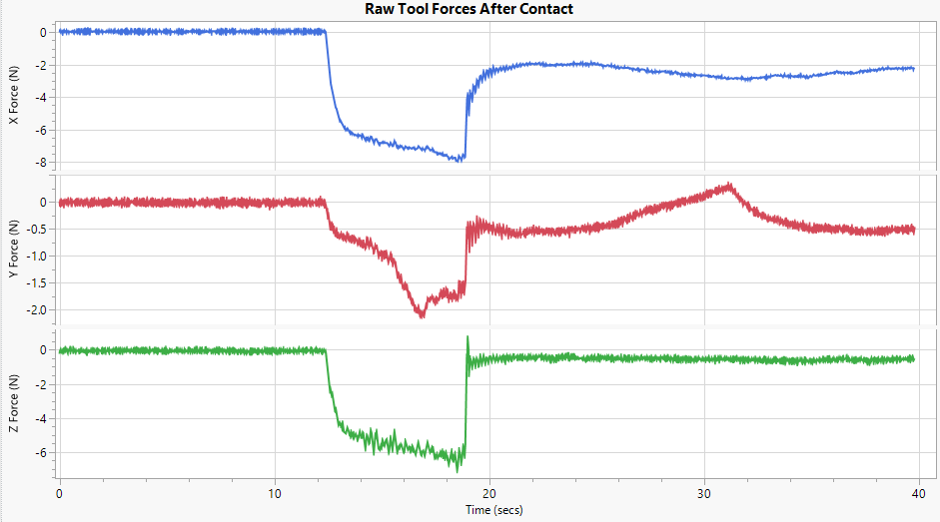
Asimov Test 405
Steady State Compliance
Transient Damping Response
Tip Leaves Chamfer
Contact
Free Space
Sliding Tube Side Contact
Chamfer Travel

Slide 23
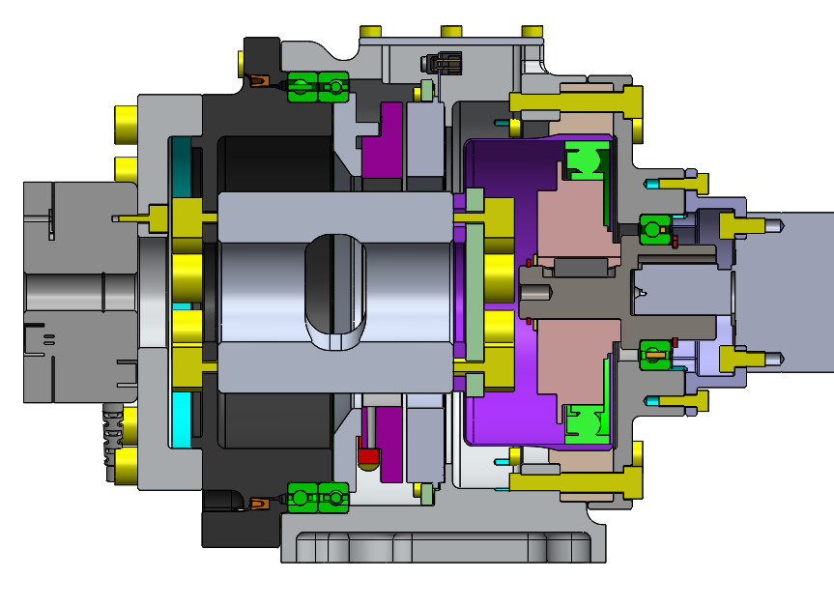
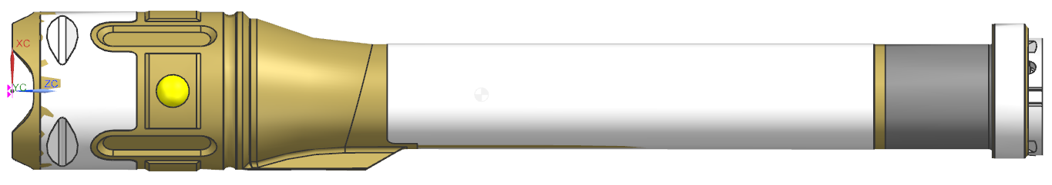

Testbed Hardware

Slide 24
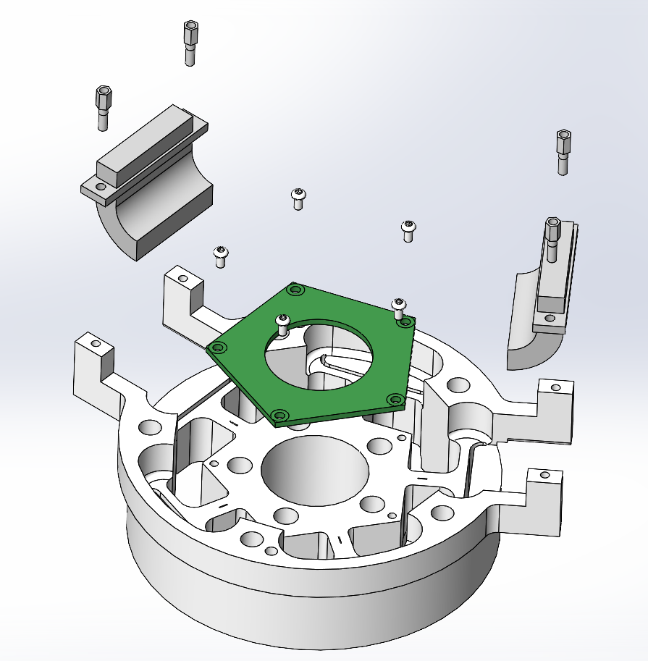
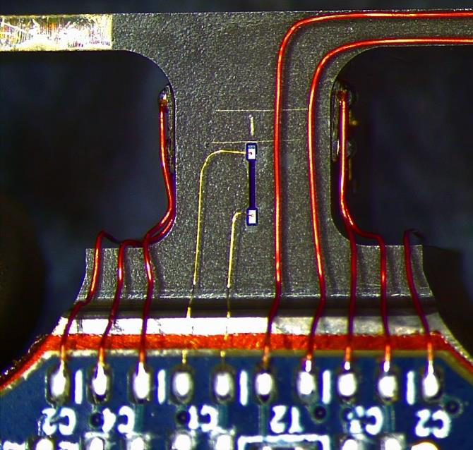
Raw images

Slide 25
Diagrams
There are FIVE identical strain beams aligned symmetrically about a central axis.
Each of the five beams has FOUR strain gauges glued to it, in the center the four sides of the rectangular cross section beam.
A pentagonal Printed Circuit Board (PCB) houses local sensing circuitry and connects the strain gauges.
Through holes in the fixture and PCB allow the plunger that actuates the ball locks on the RGA to pass through. Note that this creates an alternate load path through the FTS aside from the beams with strain gauges.
Side mounted routing boxes channel the wiring from the PCB to the arm harnessing.
4
3
5
1
2

